Slide 1
14.3 Regression Trees

Slide 2
Regression Stumps

Slide 3
Tuning the parameters of a stump-based model by minimizing an appropiate cost function (e.g., the Least Squares) is generally very difficult.
Not only is such a cost function non-convex, but it consists of staircase-like sections containing completely flat regions that no local optimization algorithm can navigate effectively.
The problematic parameter producing this effect is always the *split-point*, regardless of how the leaf values are set.

Slide 4
Determining proper split-points

Slide 5
However, all is not lost! Note that, when the leaf values are fixed the corresponding Least Squares cost *stays at the exact same level when the split-point lies in-between the input of any two datapoints*.
This means that - regardless of the values of a stump's leaves - its corresponding cost value will always *remain constant for split-point values in-between consecutive inputs*.
This fact has a very practical repercussion: we can always very easily find one candidate split-point per flat region since we need only take a point in-between each successive pair of inputs of our dataset, e.g., the *midpoint*.

Slide 6
Determining optimal leaf values for a fixed split-point

Slide 7
Since the leaves are *constant valued*, and we are using the stump as a nonlinear regressor, it makes intuitive sense to simply set the value of each leaf *to the mean of the points it will represent*.
Indeed these intuitive choices for leaf values can be determined mechanically by minimizing the Least Squares cost employing a single stump model with fixed split-point.

Slide 8
Determining optimal split-point and leaf values

Slide 9
Combining the two previous ideas provides a reasonable work-around way for tuning all three parameters of a stump to a regression dataset:
We first create a set of candidate split-point values by recording every mid-point between our input data, along each of its dimensions.
For each candidate split-point we determine the optimal stump, whose leaf values are set to the average of the training data output to the left and right of the split, and compute its (Least Squares) cost value.
Doing this for all candidate split points, finally we keep the one that provides the *lowest* cost value.

Slide 10
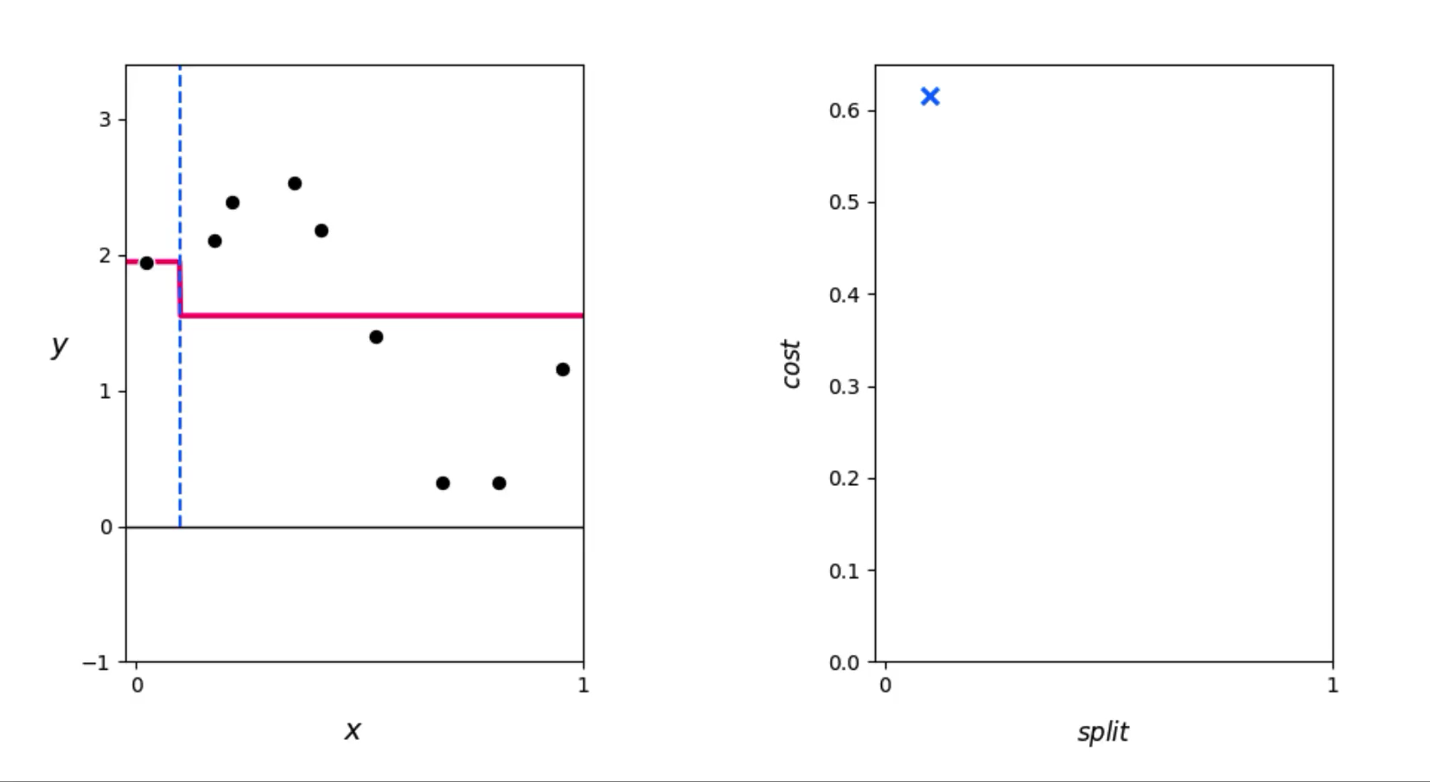

Slide 11
Regression Trees of Maximum Depth

Slide 12
To fit a depth two binary tree to a regression dataset we can first fit a stump, and then recurse on the same idea on each of the stump's leaves.
We can then go on and repeat this process - splitting each leaf of our depth two tree, creating a depth three tree, and so on.

Slide 13
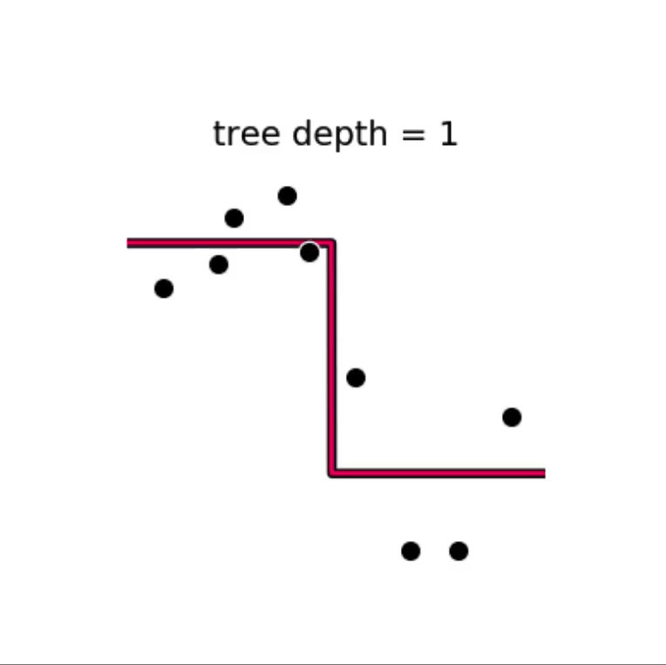

Slide 14
Notice, in the recursive process of growing a binary tree *to fit regression data*:
if any leaf ever contains just a single datapoint *we do not split the leaf containing it*.
if all datapoints contained in the input space of a leaf *have precisely the same output value* there is again no reason to split the leaf into two distinct levels, and progress should be halted as well.

Slide 15
This means that - in general - binary trees of a defined depth do not often end up 'perfect' in practice, that is where each original leaf is split exactly the same number of times.
Instead certain branches stemming from the root of the tree may halt sooner than others and be uneven in length, with some growing to the defined depth.
Thus, we refer to trees as having a *maximum depth* - the largest depth that a branch of the tree can possibly grow to.

